Slide 1
Animal Pose estimation
By: Duilio, Emilio, Esteban, Andrés, Brenda & Bruno
Pod Empanada/ Group: Monkey empanada

Slide 2
Abstract
Creating large datasets of individual and group behavior is a necessary step towards a more ecological and dynamic understanding of primate behavior and cognition. RGB cameras are a non-invasive and non-costly technology to analyze behavior . Large datasets, however, present the challenge of annotating large amounts of frames. Recent studies show convolutional neural network can be used in pose estimation to aid tracking behavior both in artificial and ecological settings. Here we analyse the performance of a U-Net(69M parameters) and a Nested U-Net(9M parameters) to track Japanese macaque pose in 50k images in the wild. Both architectures performed with similar accuracy (73%) in key-point estimation. Changes in the number of filters and layers show no significant improvement after ten epochs. An overview of the results suggests both the number of skeletons in a frame and body size should be included in the models to further improve accuracy. Overall, this study shows that, despite the complexity in natural images, general CNNs are reliable to estimate monkey pose in the wild. More complex and tailor-made architectures are promising tools to study primate behavior.
Bala, P. C., Eisenreich, B. R., Yoo, S. B. M., Hayden, B. Y., Park, H. S., & Zimmermann, J. (2020). Automated markerless pose estimation in freely moving macaques with OpenMonkeyStudio. Nature communications, 11(1), 1-12.
Labuguen, R., Matsumoto, J., Negrete, S. B., Nishimaru, H., Nishijo, H., Takada, M., ... & Shibata, T. (2021). MacaquePose: A novel “in the wild” macaque monkey pose dataset for markerless motion capture. Frontiers in behavioral neuroscience, 14, 581154.
Mathis, M. W., & Mathis, A. (2020). Deep learning tools for the measurement of animal behavior in neuroscience. Current opinion in neurobiology, 60, 1-11.
Notes:
-bruno

Slide 3
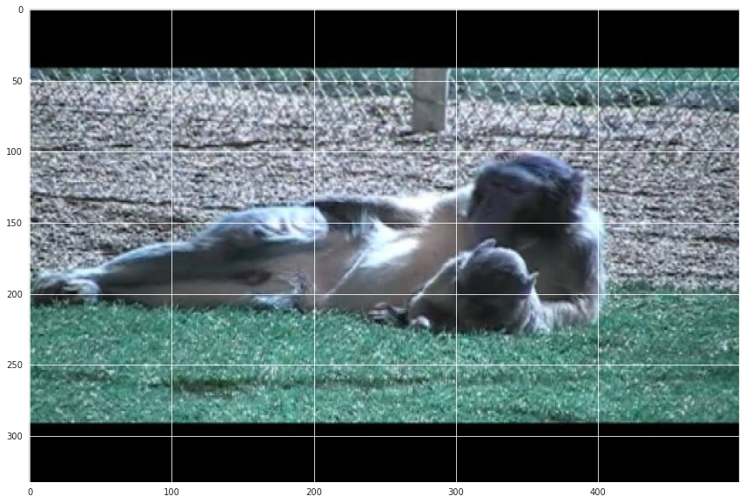

Question
Is it possible to estimate monkey pose from frames?

Slide 4
Background
- Animal pose estimation is a widely studied problem in computer vision. CNNs, based on models of the brain, are primarily used to solve difficult image-driven pattern recognition tasks and are good candidates to track body parts. (Mathis y Mathis, 2020)
- Study of monkey pose estimation has recently been promoted by the creation of large annotated datasets.
> 111,529 images of 26 species of primates (internet images and videos, photographs from three National Primate Research Centers and multiview videos in the Minnesota Zoo)
> Describir database 3D (Yao y col. 2021)
> 13,083 Google Open Images (Labuguen y col., 2021) images of macaque monkeys in zoos or primate research institute (Labuguen y col, 2021)
> 195,228 macaque monkey image in the lab from 62 views for 3D (Bala y col., 2020)
Bala, P. C., Eisenreich, B. R., Yoo, S. B. M., Hayden, B. Y., Park, H. S., & Zimmermann, J. (2020). Automated markerless pose estimation in freely moving macaques with OpenMonkeyStudio. Nature communications, 11(1), 1-12.
Labuguen, R., Matsumoto, J., Negrete, S. B., Nishimaru, H., Nishijo, H., Takada, M., ... & Shibata, T. (2021). MacaquePose: A novel “in the wild” macaque monkey pose dataset for markerless motion capture. Frontiers in behavioral neuroscience, 14, 581154.
Mathis, M. W., & Mathis, A. (2020). Deep learning tools for the measurement of animal behavior in neuroscience. Current opinion in neurobiology, 60, 1-11.
Yao, Y., Mohan, A. A., Bliss-Moreau, E., Coleman, K., Freeman, S. M., Machado, C. J., ... & Park, H. S. (2021). Openmonkeychallenge: Dataset and benchmark challenges for pose tracking of non-human primates. bioRxiv.

Slide 5
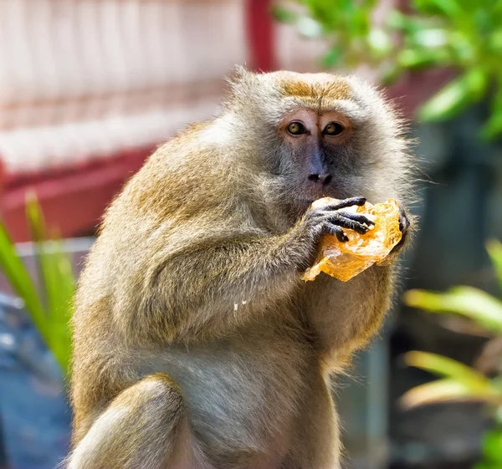
Methods
Find a database
Pick the architecture
Find computational resources
Train, test and report

Slide 6
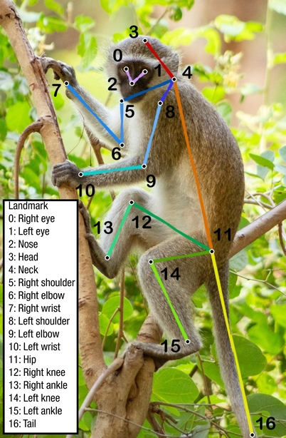
Dataset
OpenMonkeyChallenge captures images from 26 species of primates. Each image has 17 landmarks that together comprise a pose. The landmarks include several important body parts including major joints and face parts.
OPEN MONKEY CHALLENGE
Total: 111529 | Training | Validation | Test
# frames | 66917 | 22306 | 22306

Slide 7
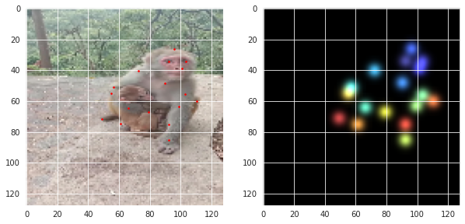
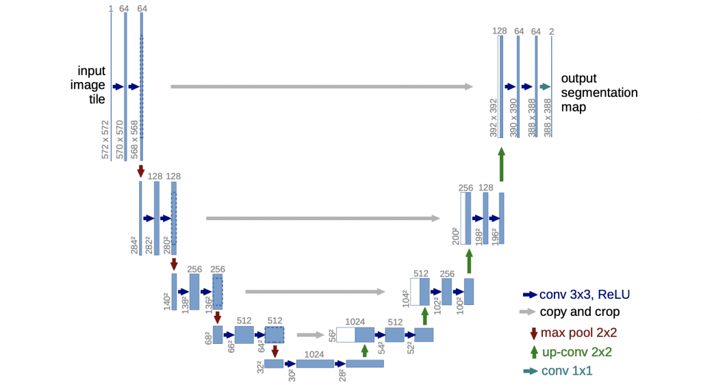
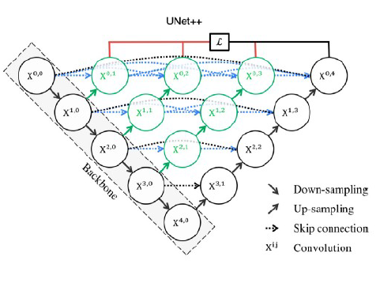
Architecture
INPUT
OUTPUT
U-NET. 5 layers
Filters: [64, 128, 256, 512, 1024]
69M parameters
Nested U-NET. 5 layers
Filters: [32, 64, 128, 256, 512]
9M parameters
Loss Function: Binary Cross Entropy
Optimizer: Adam
Accuracy: Percentage of Correct Keypoints (PCK)
Epoch number: 10
Fig 1. Example of a U-Net
Fig 2. Example of a Nested U-Net

Slide 8
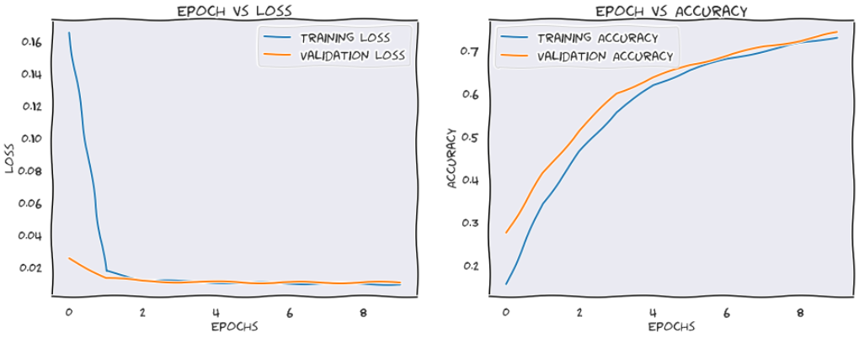
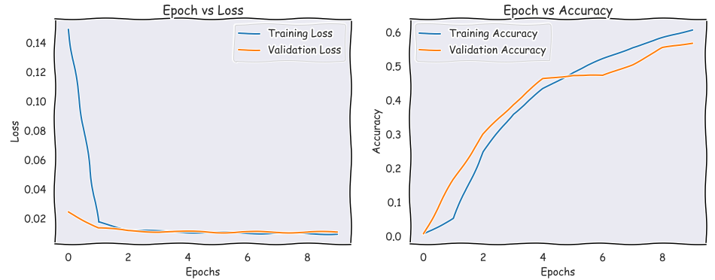
Results 1
U-NET PERFORMANCE
NESTED U-NET PERFORMANCE

Slide 9
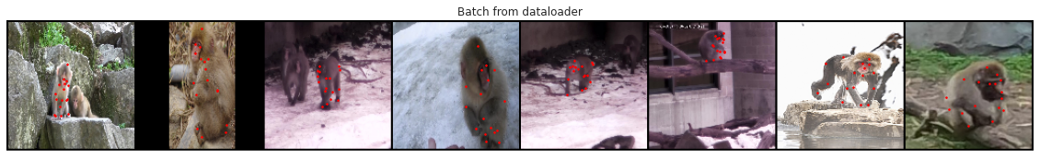
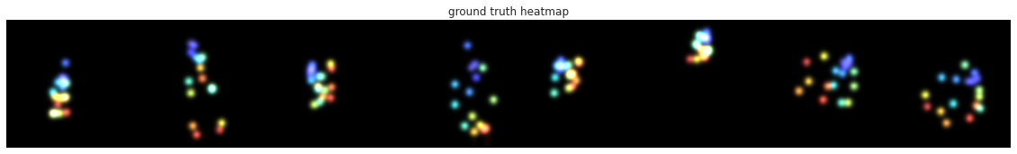
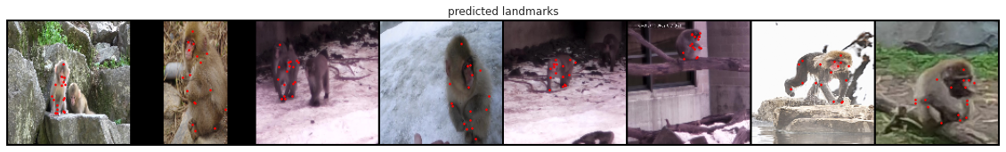
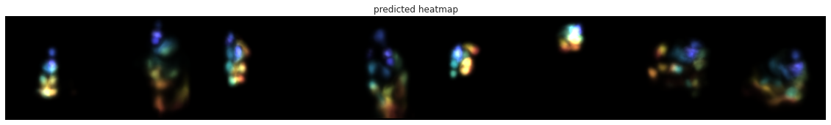
Results 2

Slide 10
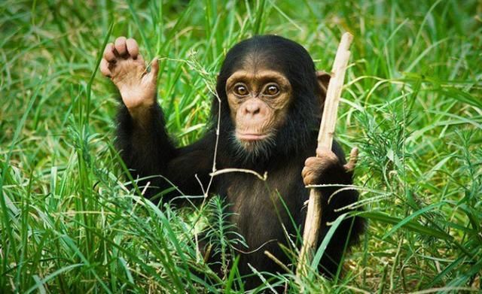
The end

